Slide 1
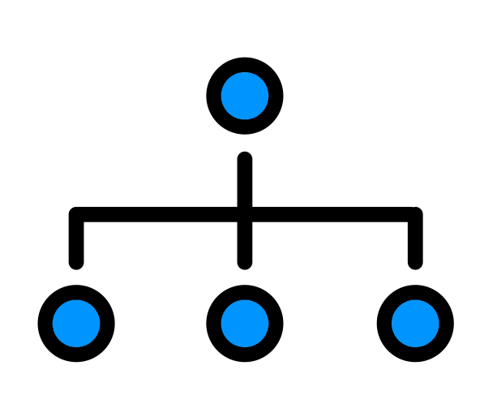



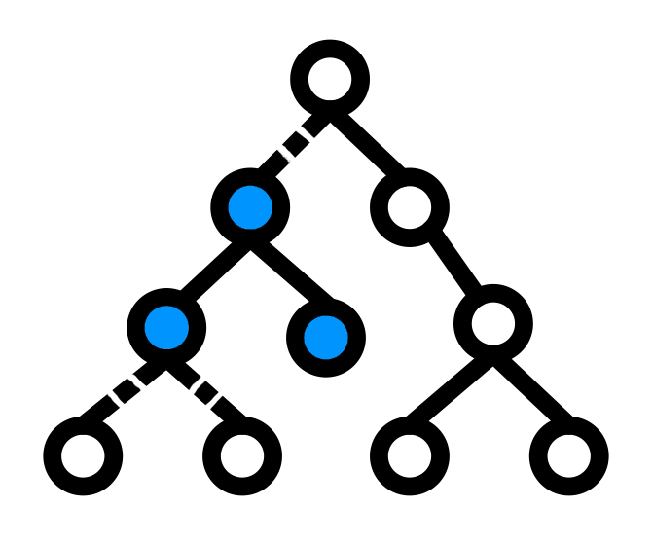

IATI
Guided Implementation
IATI Guided Implementation
Activity structure
Basic info
Linking to partners
Additional fields & documents
Financial data
Results
Kick-off, 19 April 2022

Slide 2
Agenda
Welcome & House rules
Introduction: why IATI?
What is IATI & how does it work?
Guided implementation: how & when?
Get started: homework for the next webinar
Notes:
Welcome! We are very excited you are here in such large numbers. This is the second year we do this programme we have called Guided Implementation. The first round of webinars has taught us how to improve it further, so this round will be new and improved, as they say. We hope to demystify IATI in stages and avoid overwhelming you with too much information at once.

Slide 3
Welcome!
Some house rules
Please mute your microphone.
If you have a bad connection, use the PowerPoint that was sent with the invitation and switch to audio.
We will record this and post the recording online.
We will all learn together, and you will not be the only one who needs more clarification. Please don’t be afraid to ask us to clarify things further. Please put your questions in the chat.
Please change your name to also include your organization.
Notes:
If you have objections to being recorded, you can ask your questions in the chat and ask us to not give you the floor. The list of participants and the chat will not be in the recording. You can also watch the webinar later
We understand that sometimes we use terms that not everyone understands. Please speak up when we do! (example: “I don’t know what MFA is” in the webform)

Slide 4


Who are we?
Open Data Team
Pelle Aardema
Thea Schepers
Your focal point
Notes:
NL MFA = Netherlands Ministry of Foreign Affairs
Besides us, there is also your ‘focal point’ or contact person in the ministry, who is involved with your agreement.

Slide 5



Who are you?
285 people
160 organisations
40 organisations new to IATI

Slide 6
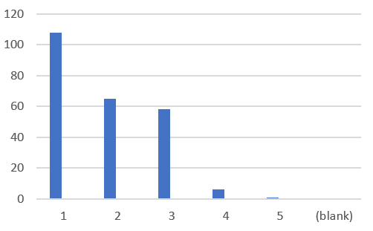
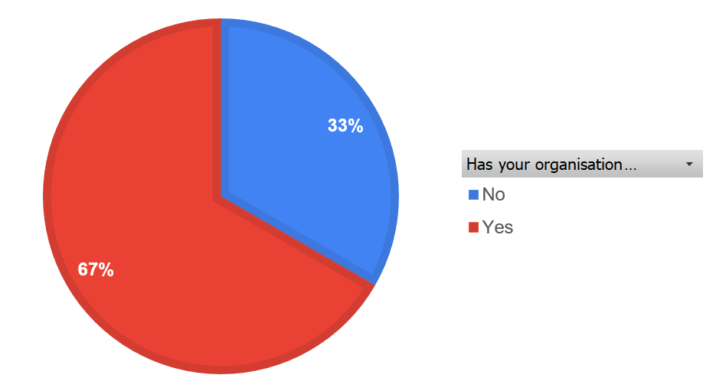
Who are you?
Has your org published before?
Level of knowledge of IATI
Notes:
You can’t see it but even among those organisations who have published, almost one-third of you considers themselves absolute beginners. Hopefully by the end of this year, you will feel differently.
One-third of you have said that your organisation has not published before, but some of you were wrong about that. More on that later.

Slide 7

Poll: where are you?
Where in the world are you?
Africa
Asia
Europe
Middle East
North America
Latin America

Slide 8
What is IATI and how does it work?

Slide 9

What is IATI?
IATI is the open data standard for development aid
Every organization involved publishes information on their projects in the same way, in a kind of template
The result is a collectively built source of data used to grow our knowledge on:
  Which organisations spend how much money in which countries to tackle which problems, and most of al: did it help?

Slide 10

The ultimate purpose
More effective aid because it is based on public, collective data
PUBLISH
Every ‘publisher’ puts data online about their activities:
Where they work, who their donor is, who they fund in turn, results etc.
USE THE DATA
NL MFA (METIS)
The partner itself (i.e. partnerships)
Governments of recipient countries
Media, politicians, etc.

Slide 11









How does it work? in a basic situation
NL MFA
data
NGO
data
NGO
data

Slide 12


How does it work? for a partnership
NL MFA
data
NGO
data
NGO
data
NGO
NGO
data
data

Slide 13



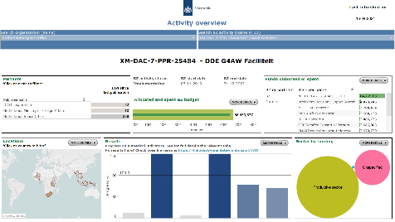
How does it work?
NL MFA
NL MFA then uses these data for:
Monitoring progress
Gathering results
Portfolio overviews
Joint insights & learning
data
NGO
data
NGO
data
NGO
NGO
data
data

Slide 14
Why do we ask you to publish in IATI?
Transparency to the Dutch public and parliament on the spending and results in development cooperation.
Provide insights for recipient countries on development aid which they would otherwise not have.
Because IATI is a network data standard, we can follow the chain of organisations involved all the way to the final activity ‘on the ground’. This creates a much better overview of what happens where.
IATI data you can analyse, PDF reports you can not.
IATI data is more current than reports after the fact.

Slide 15

What kind of information is required?
Basic Activity Information
Title
Description
Activity Status
Activity Date
Contact Info
Participating Organizations
Accountable
Funding
Implementing
Geopolitical Information
Recipient Country or Region
Location
Classifications
Sector
Policy Marker
Humanitarian Scope
Financial
Budget
Transactions
Related Documents
Document Link
Relations
Related Activity
Performance
Results

Slide 16
The IATI Standard and the Dutch Publishing Guidelines
The IATI Standard itself is
International
The minimum you should do to enable others to use your data
Very little information is required
The Dutch Publishing Guidelines are
A more specific use case of the IATI Standard
For all activities funded by the Netherlands Ministry of Foreign Affairs
The UK guidelines are identical, so these videos may be useful for UK partners as well
Unless a different donor has contradicting guidelines, you can publish all your activities according to these guidelines

Slide 17
Guided Implementation:
How & when?
Notes:
PELLE

Slide 18
Set-up IATI Guided Implementation
IATI Guided Implementation
Activity structure
Basic info
Linking to partners
Additional fields & documents
Financial data
Results
One-year program:
Quarterly webinars
We all publish the newly learnt information each quarter (first 8 weeks)
The Helpdesk gives you feedback on the data (last 4 weeks of each quarter)
Online support
Support through online community, helpdesk website &
weekly question hour
A step-by-step implementation of IATI ->
Notes:
You have plenty of time, not because we think it will be that much work, but because
We know you are busy,
We are busy too, and
This way, we follow the IATI standard of publishing every quarter

Slide 19
Timeline guided implementation
IATI Guided Implementation
Activity structure
Basic info
Linking to partners
Additional fields & documents
Financial data
Results
IATI Guided Implementation
Activity structure
Basic info
Linking to partners
Additional fields & documents
Financial data
Results
Kick-off – 19 April 2022
23 May 2022
5 September 2022
21 November 2022
20 February 2023
IATI Guided Implementation
Activity structure
Basic info
Linking to partners
Additional fields & documents
Financial data
Results
IATI Guided Implementation
Activity structure
Basic info
Linking to partners
Additional fields & documents
Financial data
Results
Notes:
This is the staircase we will take you on. Today we take the first step, which will involve some work especially for the new to iati organisations. February next year, you will all have full set of IATI data on at least one activity. We suggest you try to keep up from the start. Especially the first ‘real’ webinar, the webinar on quarter 1, is fairly difficult, but if you fall behind, chances are you will never catch up. So invest some time before summer and you will have a good foundation to build on.

Slide 20
Online support
Helpdesk website
Netherlands Corner
on IATI Connect
Consultation hours
Newsletter
Notes:
These are the ways in which you can find support in between webinars.

Slide 21
Online support
Helpdesk website
Each webinar has its own page on our Helpdesk Open Data website. It will contain:
Articles – covering the webinar’s topics in more detail
All the links you need

Slide 22
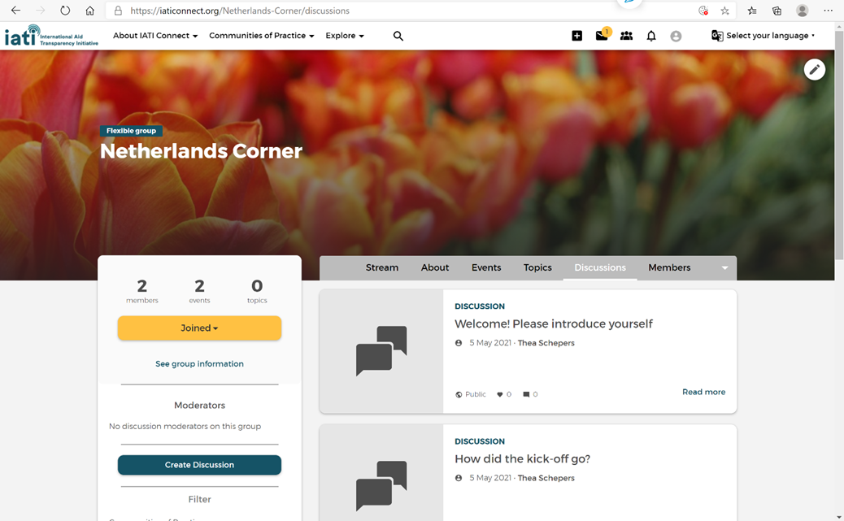
Online support
The Netherlands Corner is a section for our partners in the international IATI community platform. This is where we give feedback on your data and post updates.
If you have questions, please do not email us, but post them here in the ‘discussion’ section. This way, others with the same questions find the answer too, and it saves us a lot of time. The group is quite large, and there are only two people in the Helpdesk Open Data.
Netherlands Corner

Slide 23
Online support
Question hour
Each Thursday from 2 to 3 pm, we will be in a Zoom call to answer your questions in person. Especially useful for
Topics too sensitive for a public forum
Complex matters
There will usually be others on the call. Feel free to stay to learn from their questions or leave after you have your answers.
If necessary, we create breakout rooms.

Slide 24
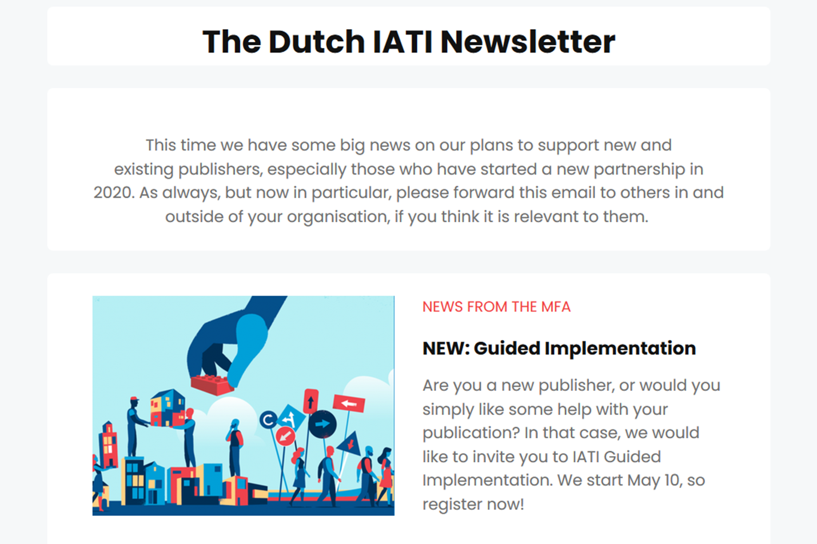
Online support
Dutch IATI Newsletter
Please subscribe to the Dutch IATI Newsletter. It is one of the channels for news from the ministry regarding IATI, and there are tips and tricks on how to improve your data.
There are also interviews with people who use IATI data to improve development aid all around the world.

Slide 25



About IATI and your organisation
Involve colleagues, don’t do it on your own!
If you leave tomorrow, they should know what to do.
Document how you publish:
- which activities
which tools
which choices did you make?
Ensure management understands the importance, and the effort involved
For your organization, and for the development sector
Notes:
If anyone new is joining later, make sure they join before the next webinar, and that they have seen the recording of this webinar.

Slide 26
A word about deadlines
Guided Implementation deadlines ≠ Ministry of Foreign Affairs deadlines
You are here voluntarily. We are not going to be strict on our deadlines.
The official Ministry of Foreign Affairs reporting deadlines are strict deadlines. If our schedule conflicts with the demands in your agreement, discuss with your Focal Point (contact person)
23 May 2022
5 September 2022
21 November 2022
20 February 2023
Reporting deadline?
✗
Guided Implementation

Slide 27
If your organisation is new to IATI
Notes:
THEA

Slide 28
Prepare… and start now
Determine an identifier for your organisation
Register your organisation at the IATI registry: http://iatiregistry.org
Select a tool to publish IATI – there are several options.
Discuss in your organisation which activities you are going to publish, and what the definition of ‘activity’ is in your situation.
Notes:
If your organisation is entirely new to IATI, there is some preparation.

Slide 29
1. Create an identifier for your organisation
In IATI, every organisation has a unique code to identify the organisation.
For example:
this code consists of
Steps you need to take:
Identifiy your registration agency through http://org-id.guide/
Find your registration number
For a full description of the steps to follow, go to the Helpdesk website
NL-KVK-23456789
a code for the registration agency
the registration number for the organisation

Slide 30
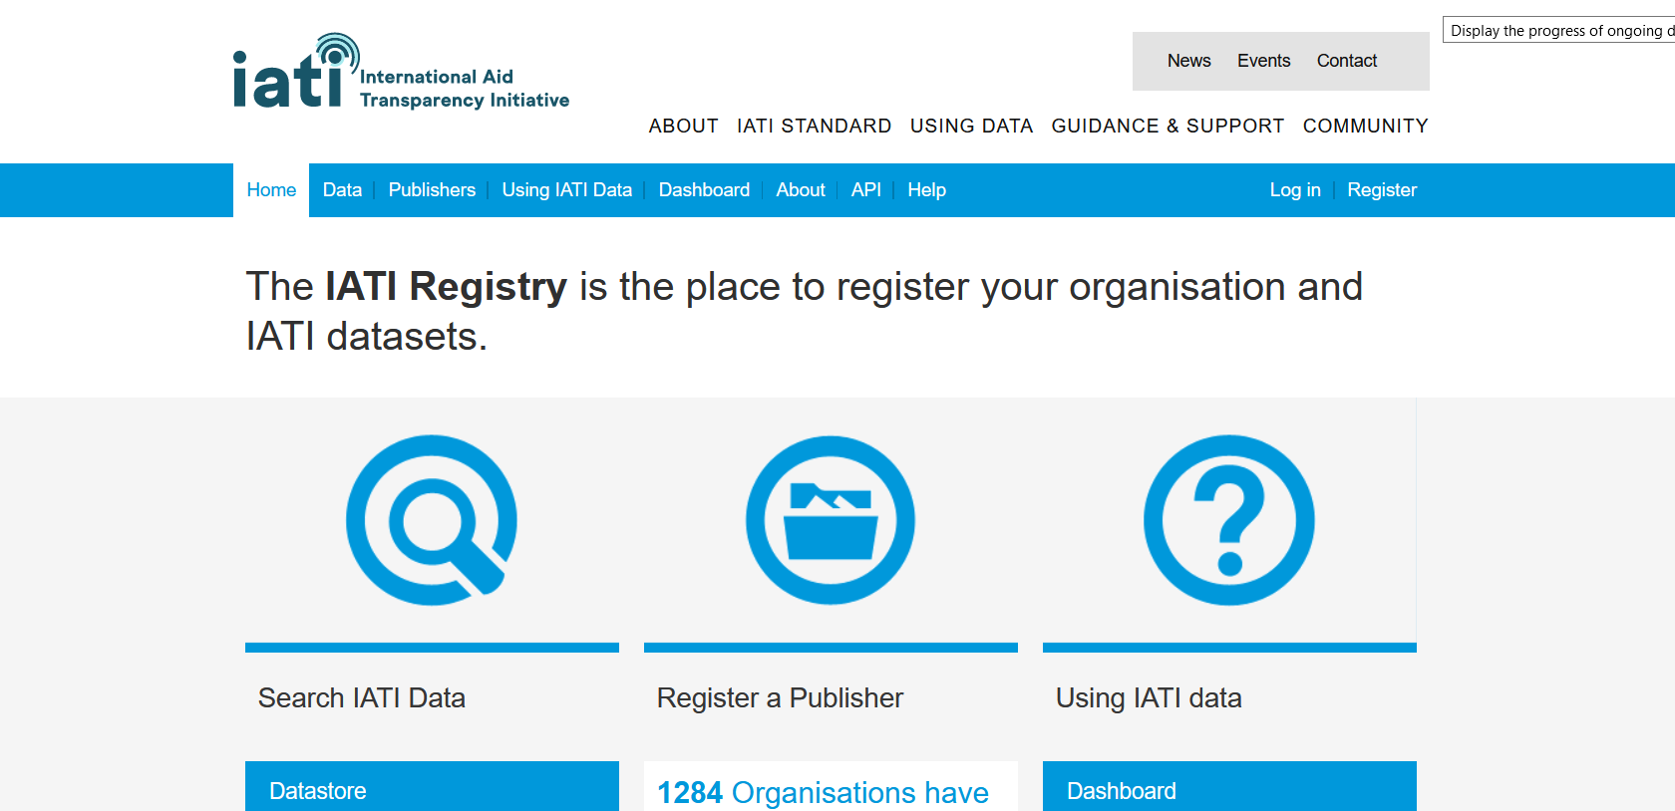
2. Create a publisher account at the IATI Registry
Check in the Registry if your organisation has not published in the past.
If not, create an account at www.iatiregistry.org
Notes:
If you are stuck anywhere in the process of creating a publisher account, contact IATI Support on support@iatistandard.org. This is not us, but a helpdesk for the IATI Registry specifically. They approve your Organisation Identifier and can help if there are issues.

Slide 31
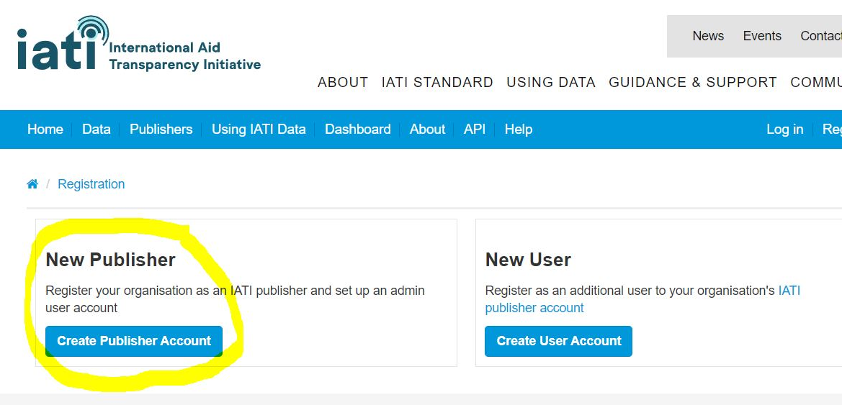
2. Create a publisher account at the IATI Registry (2)
2. When you are logged in to the IATI registry, create a publisher
For a full description of the steps to follow, go to the Helpdesk website

Slide 32
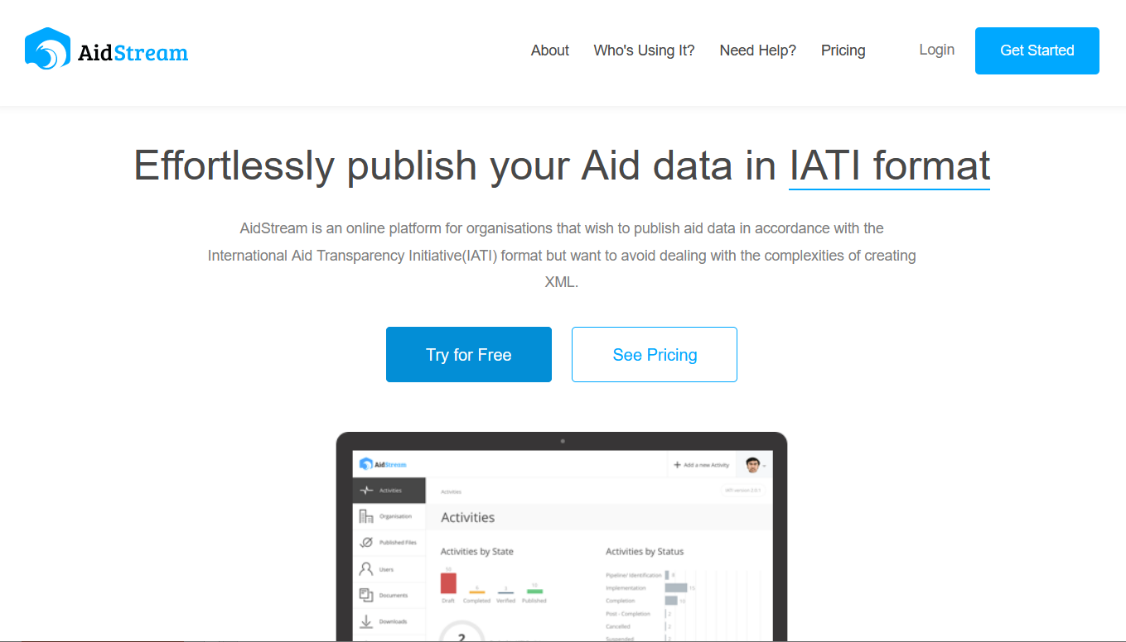
3. Create an Aidstream account – (if applicable)
If your organisation will be using Aidstream, set up your account on aidstream.org
Steps you need to take:
Go through the set-up process
For a full IATI publication, some default settings need to be changed.
Find a full description of the steps to follow, at the Helpdesk website
Notes:
Aidstream is by no means the only publishing tool and we make no recommendation on which tool to use. Aidstream is, however, the tool that most beginning publishers use. To provide the best help we can, we will cover the basics in Aidstream in most webinars. If you use a different tool, you will most likely have support already.

Slide 33
Think about activities
What is an activity in your organisation?
Often it is synonymous with ‘project’
Each has its own budget, location information, start and end date, et cetera
Ultimately, you decide on this – within the spirit of the IATI standard and within the guidelines of the MFA
What not to do:
Don’t make each result its own activity – way too much work!
Don’t create a new activity every quarter – even more work!
You also don’t need to give it the same ID as our activity
For more on this, go to the article on the
Helpdesk website
Notes:
More details will follow in the webinar for Quarter 1.

Slide 34


To summarise the process
Gather your project information
Turn it into IATI code
Publish on the
IATI registry
… or a different solution
your IATI registry account
your Aidstream account
Support &
community
your IATI Connect account
Netherlands Corner
on IATI Connect
Notes:
This means three accounts that you need to create.

Slide 35

Start now!
Notes:
It may take some time to register, because the IATI secretariat needs to approve your registration. From last year we have learnt that people underestimate this. If you can’t start the actual publishing in May, you will be behind from the start and run the risk of dropping out.

Slide 36
If your organisation has published before

Slide 37
If your organisation has published IATI data before...
Determine an identifier for your organisation
Register your organisation at the IATI registry: http://iatiregistry.org
Find out how your organisation published – and who is responsible
Notes:
If your organisation is not new to IATI, there is a lot less to prepare. The identifier exists, you are on the Registry already, and most likely you also have a system to publish. The last point still sometimes applies: how to define what is an activity in your situation. A few existing publishers are still doing this wrong, and some of those may be in this meeting. We will discuss it more in the webinar for Quarter 1, in May. If you are unsure, come and ask us in the Question Hour or on the Netherlands Corner if you are on the right track. It is very possible that you will save yourself a lot of work.

Slide 38

If your organisation has published IATI data before...
Read the article What is an activity? and check if your organisation has defined its activities well.
Discuss in your organisation which activities should be improved, or which activities you should publish
Create an account at the Netherlands Corner
Sign up for the Newsletter
Notes:
If your organisation is not new to IATI, there is a lot less to prepare. The identifier exists, you are on the Registry already, and most likely you also have a system to publish. The last point still sometimes applies: how to define what is an activity in your situation. A few existing publishers are still doing this wrong, and some of those may be in this meeting. We will discuss it more in the webinar for Quarter 1, in May. If you are unsure, come and ask us in the Question Hour or on the Netherlands Corner if you are on the right track. It is very possible that you will save yourself a lot of work.

Slide 39

Next time:
Quarter 1
Notes:
Next time is the most difficult quarter. Especially if you are the lead of an alliance, you will have a lot of work to do. But getting it right in the first webinar, no matter what kind of activities you do, will make things much easier for the whole activity’s time. Therefore, make sure the preparation is all done, and you are all set to start on May 23rd. And remember, we are here to help you every step of the way.

Slide 40
Next time we’ll focus on
What is an ‘activity’
And how do you define your own activities
The basic information needed for each activity
Activity structure
Basic info

Slide 41

Keep in touch
http://helpdesk-opendata-minbuza.nl
http://iaticonnect.org/netherlands-corner
Question hours: each Thursday 2-3pm
Sign up for our newsletter
Exception:
21 April: Question hour will be earlier, 12.00 CEST
28 April: No question hour ☹
Notes:
If you know anyone who should join, sign up is still possible!

Slide 42
Thank you!

